Slide 1

Comparative Analysis of Deep Learning Models for Face Anti-Spoofing in Secure Biometric Authentication
School of Computer Science and Engineering
Department of Computer Science and Engineering
Submitted By: Eshanya Padial(23Fe10cse00592)
Jai Sachdeva(23Fe10cse00455)
Supervised By:
Ms. Neha Singh

Slide 2
Outline
Introduction
Literature Review
Problem Statement
Proposed Methodology
Results & Comparison
Conclusion & Future Scope
References

Slide 3
Introduction
Biometric authentication is widely used for secure identity verification
Face recognition is popular due to:
Non-intrusive nature
Easy deployment
Smartphone compatibility
Increasing use in banking, surveillance, and mobile security

Slide 4
Face recognition systems are vulnerable to:
Printed image attacks
Replay/video attacks
Deepfake attacks
Deepfake generation using GANs makes spoofing harder to detect
Need for robust face anti-spoofing systems

Slide 5
Literature Review
Traditional Approaches :
Local Binary Patterns
Histogram of Oriented Patterns
Advantage: Low Computational Cost
Disadvantages:Sensitive to lighting and pose and Poor generalization

Slide 6
Literature Review
Deep Learning Approaches : CNN Based Model like VGG etc
Advantages : Automatic feature extraction and higher accuracy.
Disadvantages : Requires large datasets and very high computational cost

Slide 7
Literature Review
Advanced Architecture Approaches : ResNet50 , MobileNetV2 and EfficientNetB0
Emerging Techniques:Transformers(ViT) and Multimodal Systems
Challenges : Real time performance and unknown attack detection

Slide 8
Evolution of Anti Spoofing Techniques

Slide 9
Problem Statement
To research and compare three deep learning models (MobileNetV2, ResNet50, EfficientNetB0) for face anti-spoofing and develop a full functional authentication system based on the best-performing model.

Slide 10
Objectives
Compare performance of three CNN Models
Detect real vs spoofed faces accurately
Identify best model based on metrics
Develop a real time face authentication system

Slide 11
Proposed Methodology
System Workflow
Input: Facial images dataset
Preprocessing: Resize, Normalize
Feature Extraction using CNN
Binary Classification (Real/Fake)
Performance Evaluation

Slide 12
Methodology
Data Handling
Dataset split:
Training
Validation
Testing
Label encoding:
Real = 1
Fake = 0
Data augmentation:
Flipping
Brightness/contrast adjustment
Model Architecture
Models used:
MobileNetV2
ResNet50
EfficientNetB0
Transfer learning:
Pretrained on ImageNet
Freeze base layers
Classification head:
Dense layer (256)
Dropout (0.4)
Sigmoid output

Slide 13
Methodology
Training & Evaluation
Optimizer: Adam
Learning Rate: 0.001
Loss: Binary Cross-Entropy
Epochs: 3
Metrics:
Accuracy
AUC
Precision
Recall
F1 Score
Optimization:
EarlyStopping
ModelCheckpoint

Slide 14
Data Flow Diagram

Slide 15
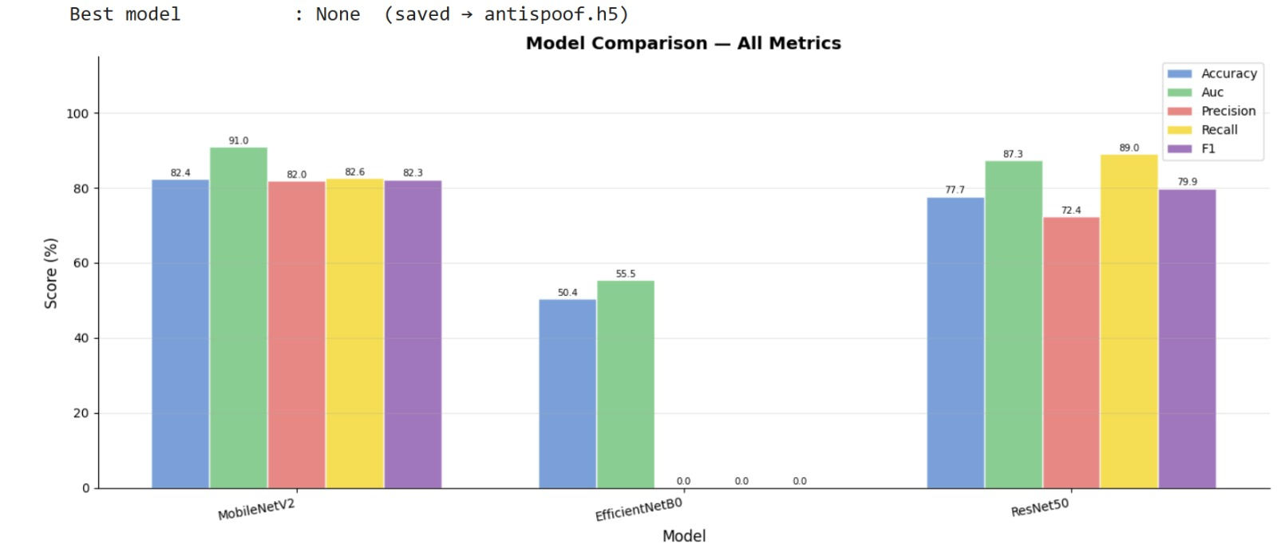
Result
The bar chart provides a visual comparison of the model performance in terms of accuracy, AUC, precision, recall and F1-score. MobileNetV2 scores the best in all measures, which means that it performs better and equally. ResNet50 has average results in terms of recall and less precision. The results of EfficientNetB0 are very poor which proves that it is not learning effectively in this case

Slide 16
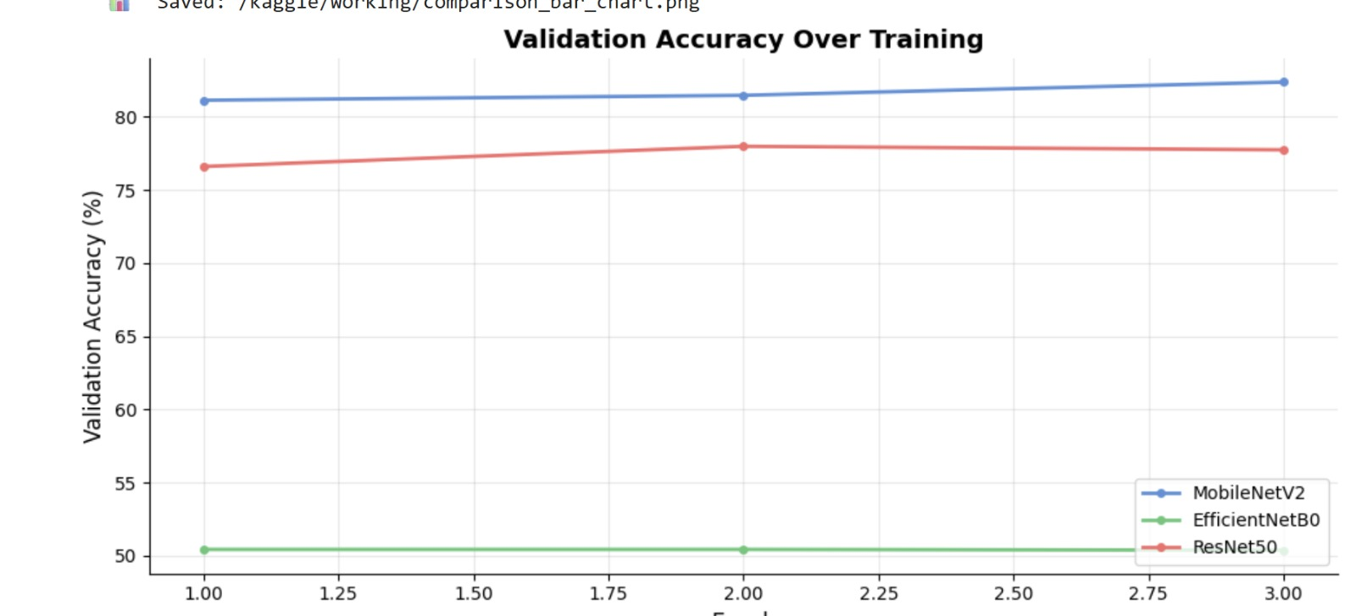
Result
The plot on the validation accuracy shows learning trends of the model with epochs. MobileNetV2 is steadily improving meaning that it has converged and learned successfully. ResNet50 shows slow progressive change with a few variations, which is indicative of a mediocre learning ability. Conversely, EfficientNetB0 is almost stable at 50% which validates its inability to learn meaningful patterns and indicates the presence of obvious underfitting behaviour

Slide 17
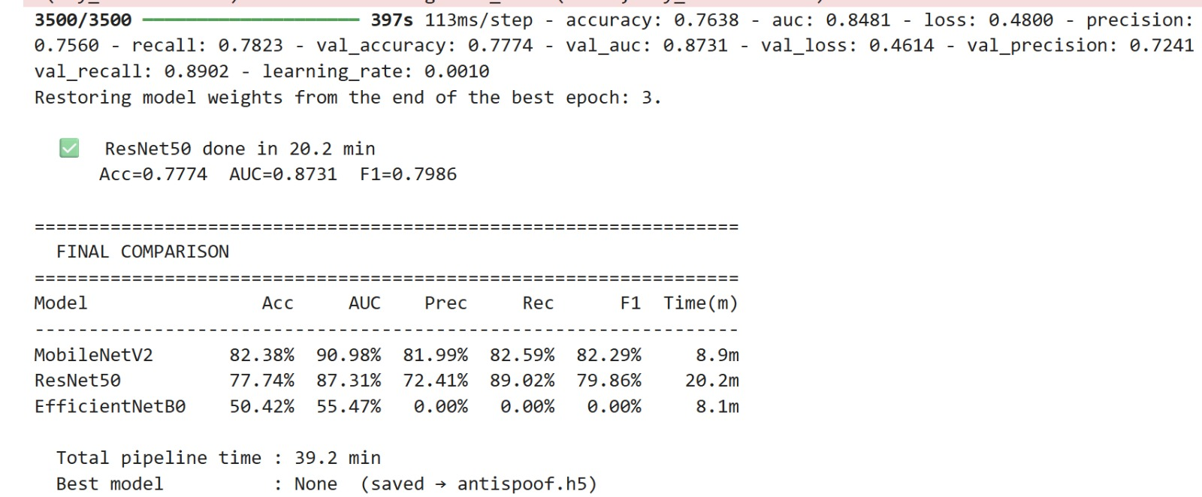
Result
The final comparison shows that MobileNetV2 outperforms all models, achieving the highest accuracy (82.39%) and AUC (90.98%) with efficient training time (8.9 min). ResNet50 provides competitive performance with strong recall but requires significantly more computation time. EfficientNetB0 performs poorly, indicating failure to learn meaningful features. Overall, MobileNetV2 offers the best balance between performance and efficiency

Slide 18
Outcome
A functional face anti-spoofing authentication system has been successfully developed using deep learning.
Comparative analysis of MobileNetV2, ResNet50, and EfficientNetB0 has been completed, with MobileNetV2 selected as the best-performing model.
The research paper has been drafted and is ready for submission.

Slide 19
References
Sandler et al. – MobileNetV2 (2018)
He et al. – ResNet50 (2016)
Tan & Le – EfficientNet (2019)
Goodfellow et al. – GAN (2014)
Dosovitskiy et al. – Vision Transformers (2021)
Liu et al. – Face Anti-Spoofing Models (2018)

Slide 20
Thank You

